Slide 1
Comparing several means: ANOVA (GLM 1)
Chapter 10

Slide 2
When And Why
When we want to compare means we can use a t-test. This test has limitations:
You can compare only 2 means: often we would like to compare means from 3 or more groups.
It can be used only with one Predictor/Independent Variable.

Slide 3
When And Why
ANOVA
Compares several means.
Can be used when you have manipulated more than one Independent Variables.
It is an extension of regression (the General Linear Model).

Slide 4
Why Not Use Lots of t-Tests?
If we want to compare several means why don’t we compare pairs of means with t-tests?
Can’t look at several independent variables.
Inflates the Type I error rate.
1
1
2
Vs
1
3
Vs
2
3
2
Vs
3

Slide 5
Type 1 error rate
Formula = 1 – (1-alpha)^{c}
Alpha = type 1 error rate = .05 usually (that’s why the last slide had .95)
C = number of comparisons
Familywise = across a set tests for one hypothesis
Experimentwise = across the entire experiment

Slide 6
Regression v ANOVA
ANOVA in Regression:
Used to assess whether the regression model is good at predicting an outcome.
ANOVA in Experiments:
Used to see whether experimental manipulations lead to differences in performance on an outcome (DV).
By manipulating a predictor variable can we cause (and therefore predict) a change in behavior?
Actually can be the same question!

Slide 7
What Does ANOVA Tell us?
Null Hyothesis:
Like a t-test, ANOVA tests the null hypothesis that the means are the same.
Experimental Hypothesis:
The means differ.
ANOVA is an Omnibus test
It test for an overall difference between groups.
It tells us that the group means are different.
It doesn’t tell us exactly which means differ.

Slide 8
Theory of ANOVA
We compare the amount of variability explained by the Model (experiment), to the error in the model (individual differences)
This ratio is called the F-ratio.
If the model explains a lot more variability than it can’t explain, then the experimental manipulation has had a significant effect on the outcome (DV).

Slide 9
F-ratio
Variance created by our manipulation
Removal of brain (systematic variance)
Variance created by unknown factors
E.g. Differences in ability (unsystematic variance)
Drawing here.
F-ratio = systematic / unsystematic
But now these formulas are more complicated

Slide 10
Theory of ANOVA
We calculate how much variability there is between scores
Total Sum of squares (SS_{T}).
We then calculate how much of this variability can be explained by the model we fit to the data
How much variability is due to the experimental manipulation, Model Sum of Squares (SS_{M})...
… and how much cannot be explained
How much variability is due to individual differences in performance, Residual Sum of Squares (SS_{R}).

Slide 11
Theory of ANOVA
If the experiment is successful, then the model will explain more variance than it can’t
SS_{M} will be greater than SS_{R}

Slide 12
ANOVA by Hand
Testing the effects of Viagra on Libido using three groups:
Placebo (Sugar Pill)
Low Dose Viagra
High Dose Viagra
The Outcome/Dependent Variable (DV) was an objective measure of Libido.

Slide 13
The Data

Slide 14
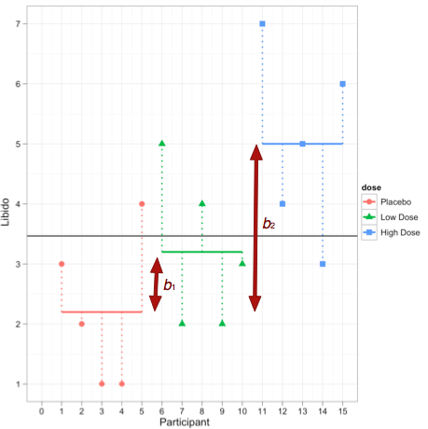
The data:

Slide 15
Step 1: Calculate SS_{T}

Slide 16
Total Sum of Squares (SS_{T}):
Grand Mean

Slide 17
Degrees of Freedom (df)
Degrees of Freedom (df) are the number of values that are free to vary.
In general, the df are one less than the number of values used to calculate the SS.

Slide 18
Step 2: Calculate SS_{M}

Slide 19
Model Sum of Squares (SS_{M}):
Grand Mean

Slide 20
Model Degrees of Freedom
How many values did we use to calculate SS_{M}?
We used the 3 means (levels).

Slide 21
Step 3: Calculate SS_{R}

Slide 22
Residual Sum of Squares (SS_{R}):
Grand Mean
Df = 4
Df = 4
Df = 4

Slide 23
Step 3: Calculate SS_{R}

Slide 24
Residual Degrees of Freedom
How many values did we use to calculate SS_{R}?
We used the 5 scores for each of the SS for each group.

Slide 25
Double Check

Slide 26
Step 4: Calculate the Mean Squared Error

Slide 27
Step 5: Calculate the F-Ratio

Slide 28
Step 6: Construct a Summary Table
Source | SS | df | MS | F
Model | 20.14 | 2 | 10.067 | 5.12*
Residual | 23.60 | 12 | 1.967
Total | 43.74 | 14

Slide 29
F-tables
Now we’ve got two sets of degrees of freedom
DF model (treatment)
DF residual (error)
Model will usually be smaller, so runs across the top of a table
Residual will be larger and runs down the side of the table.

Slide 30
F-values
Since all these formulas are based on variances, F values are never negative.
Think about the logic (model / error)
If your values are small you are saying model = error = just a bunch of noise because people are different
If your values are large then model > error, which means you are finding an effect.

Slide 31
Assumptions
Data screening: accuracy, missing, outliers
Normality
Linearity (it is called the general linear model!)
Homogeneity – Levene’s (new!)
Homoscedasticity (still a form of regression)
So you can do the normal screening we’ve already done and add Levene’s test.

Slide 32
Assumptions
How to calculate Levene’s test:
Load the car library! (be sure it’s installed)
leveneTest(Y ~ X, data = data, center = mean)
Remember that’s the same set up as t.test.
We are going to use a mean center since we are using the mean as our model.

Slide 33
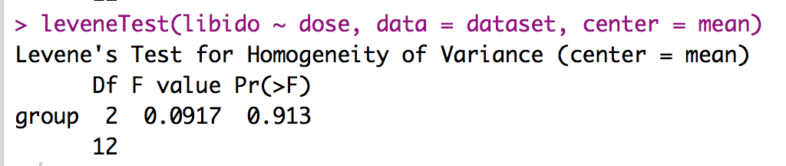
Assumptions
Levene’s Test output
What are we looking for?

Slide 34
Assumptions
ANOVA is often called a “robust test”
What? Robustness = ability to still give you accurate results even though the assumptions are bent.
Yes mostly:
When groups are equal
When sample sizes are sufficiently large

Slide 35
Run the ANOVA!
We are going to use the aov function.
Save the output so can you use it for other things we are going to do later.
output = aov(Y ~X, data = data)
Summary(output)

Slide 36
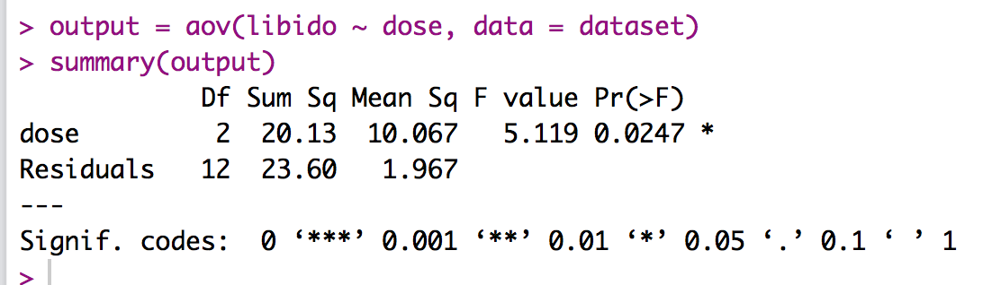
Run the ANOVA!

Slide 37
Run the ANOVA!
What do you do if homogeneity test was significant? (Levene’s)
Run a Welch correction on the ANOVA using the oneway function.
oneway.test(Y ~ X, data = data)
Note, you don’t save this one – the summary function does not work the same.

Slide 38
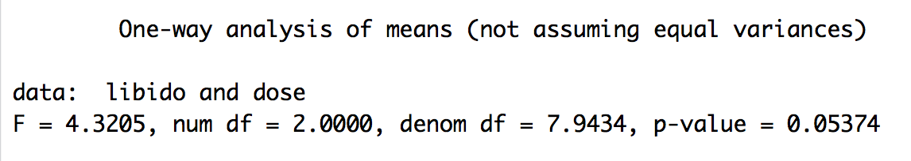
Run the ANOVA!

Slide 39
APA – just F-test part
There was a significant effect of Viagra on levels of libido, F(2, 12) = 5.12, p = .03, η²= .46.
We will talk about Means, SD/SE as part of the post hoc test.

Slide 40
Effect size for the ANOVA
In ANOVA, there are two effect sizes – one for the overall (omnibus) test and one for the follow up tests (coming next).
Let’s talk about the overall test:
F-test
R²
η²
ω²

Slide 41
Effect size for the ANOVA
R² and ɳ²
Proportion of variability accounted for by an effect
Useful when you have more than two means, gives you the total good variance with 3+ means
Small = .01, medium = .06, large = .15
Can only be positive
Range from .00 – 1.00

Slide 42
Effect size for the ANOVA
R² – more traditionally listed with regression
ɳ² – more traditionally listed with ANOVA
SSModel/SStotal
Remember total = model + residuals
Clearly, you have these numbers, but you can also use the summary.lm(output) function to get that number.

Slide 43
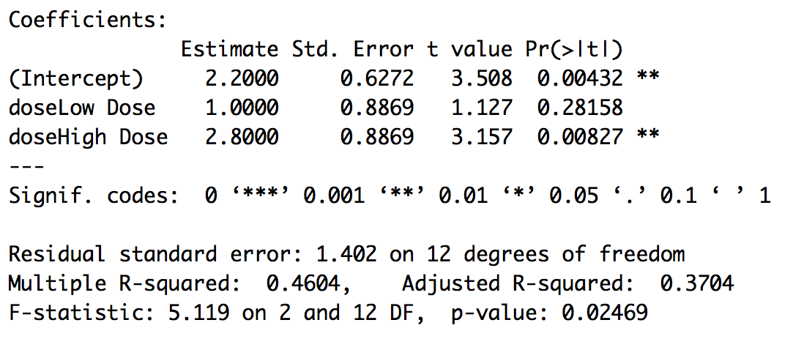
Effect size for the ANOVA

Slide 44
Effect size for the ANOVA
ω²
R² and d tend to overestimate effect size
Omega squared is an R² style effect size (variance accounted for) that estimates effect size on population parameters
SSM – (dfM)*MSR
SStotal + MSR

Slide 45
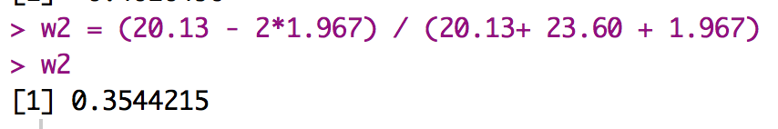
Effect size for the ANOVA

Slide 46
Post Hocs and Trends

Slide 47
Why Use Follow-Up Tests?
The F-ratio tells us only that the experiment was successful
i.e. group means were different
It does not tell us specifically which group means differ from which.
We need additional tests to find out where the group differences lie.

Slide 48
How?
Multiple t-tests
We saw earlier that this is a bad idea
Orthogonal Contrasts/Comparisons
Hypothesis driven
Planned a priori
Post Hoc Tests
Not Planned (no hypothesis)
Compare all pairs of means
Trend Analysis

Slide 49
Post Hoc Tests
Compare each mean against all others.
In general terms they use a stricter criterion to accept an effect as significant.
TEST = t.test or F.test
CORRECTION = None, Bonferroni, Tukey, SNK, Scheffe

Slide 50
Post Hoc Tests
For all of these post hocs, we are going to use t-test to calculate the if the differences between means is significant.
A least significant difference test (aka the t-test) is the same as doing all pairwise t-values
We’ve already decided that wasn’t a good idea.
Let’s calculate it as a comparison though.

Slide 51
Post Hoc Tests
We are going to use the agricolae library – install and load it up!
All of these functions have the same basic format:
Function name
Saved aov output
“IV”
group = FALSE
console = TRUE

Slide 52
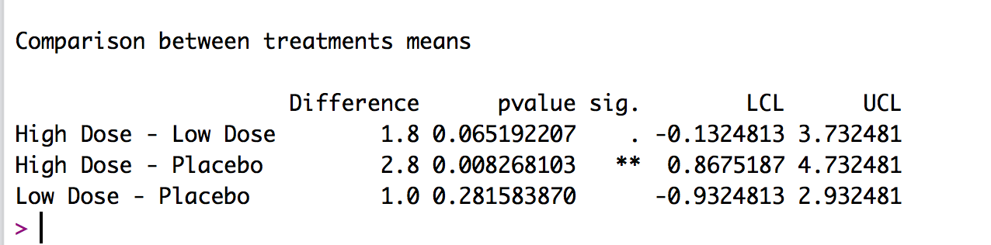
Post Hoc Tests - LSD

Slide 53
Post Hoc Tests - Bonferroni
Restricted sets of contrasts – these tests are better with smaller families of hypotheses (i.e. less comparisons over they get overly strict).
These tests adjust the required p value needed for significance.
Bonferroni – through some fancy math, we’ve shown that the family wise error rate is < number of comparisons times alpha. Afw < c(alpha)

Slide 54
Post Hoc Tests - Bonferroni
Therefore it’s easy to correct for the problem by dividing afw by c to control where alpha = afw / c
However, Bonferroni will over correct for large number of tests
Other types of restricted contrasts:
Sidak-Bonferroni
Dunnett’s test

Slide 55
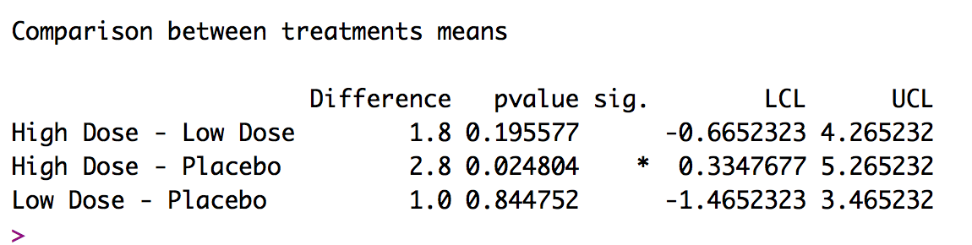
Post Hoc Tests - Bonferroni

Slide 56
Post Hoc Tests - SNK
Pairwise comparisons – basically when you want to run everything compared to everything
These tests correct on the smallest mean difference for it to be significant – rather than adjust p values.
Student Newman Keuls
Considered a walk down procedure: tests differences in order of magnitude
However, this test also increases type 1 error rate for those smaller differences in means.

Slide 57
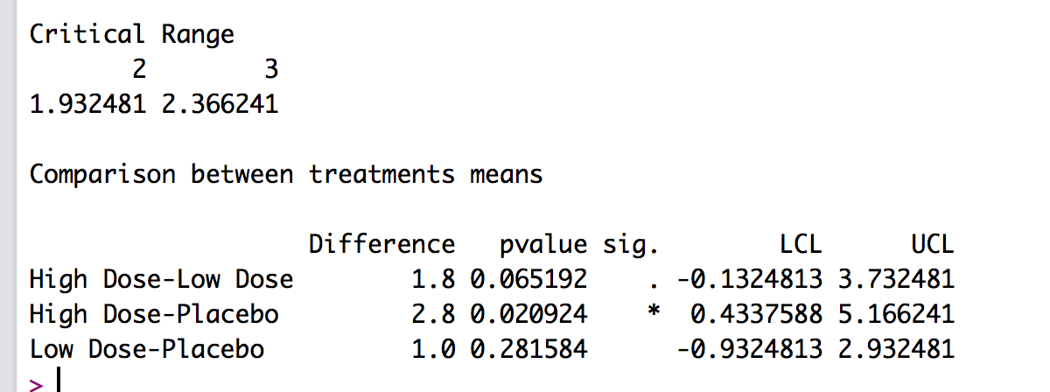
Post Hoc Tests - SNK

Slide 58
Post Hoc Tests – Tukey HSD
Most popular way to correct for Type 1 error problems
HSD = honestly significant difference
Other types of pairwise comparisons
Fisher Hayter
Ryan Einot Gabriel Welch (REGW)

Slide 59
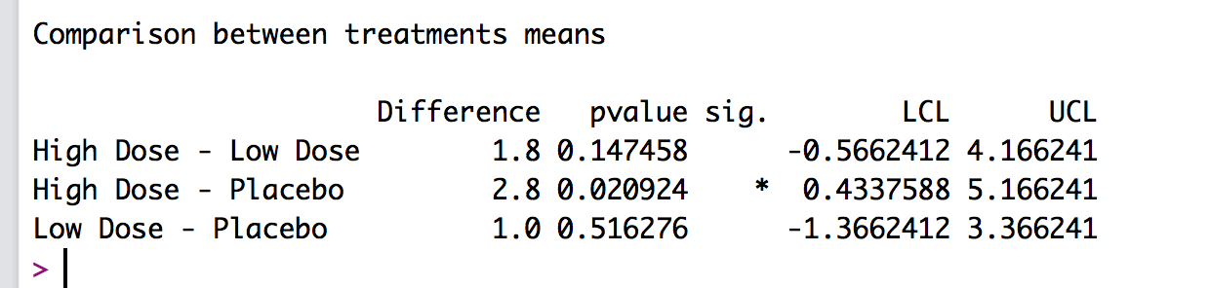
Post Hoc Tests – Tukey HSD

Slide 60
Post Hoc Tests - Scheffe
Post – Hoc error correction – these tests are for more exploratory data analyses.
These types of tests normally control alpha experiment wise, which makes them more stringent.
Controls for all possible combinations (including complex contrasts) – over what we discussed before.
These correct the needed cut off value (similar to adjusting p).

Slide 61
Post Hoc Tests - Scheffe
Scheffe – corrects the cut off score for the F test when doing post hoc comparisons

Slide 62
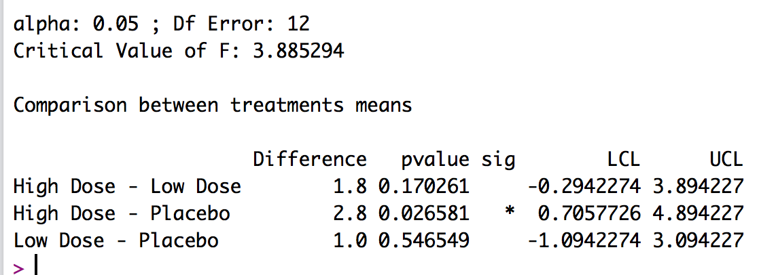
Post Hoc Tests - Scheffe

Slide 63
Trend Analyses
Quadratic Trend = a curve across levels
Cubic Trend = two changes in direction of trend
Quartic Trend = three changes in direction of trend

Slide 64
Trend Analysis

Slide 65
Trend Analysis in R
First, we have to set up the data:
k = 3 ##set to the number of groups
contrasts(IV column) = contr.poly(k) ##note this does change the original dataset
Then run the exact same ANOVA code we did before:
output = aov(libido ~ dose, data = dataset)
summary.lm(output)

Slide 66
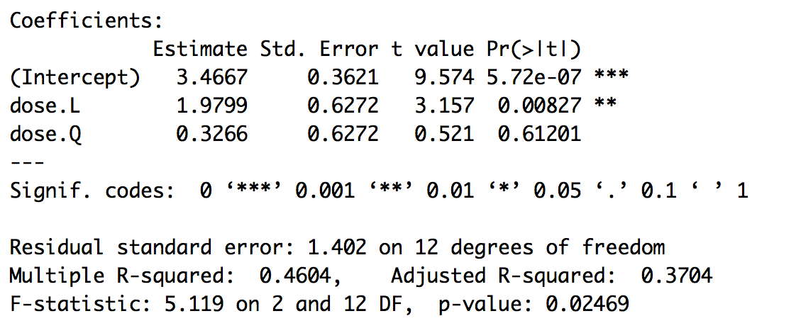
Trend Analysis in R

Slide 67
Reporting Results
There was a significant linear trend, t(12) = 3.157, p = .008, indicating that as the dose of Viagra increased, libido increased proportionately.

Slide 68
Effect Size
Since we are comparing two groups, we want to calculate d or g values for each pairwise comparison.
Remember to get the means, sds, and n for each group using tapply().

Slide 69
Reporting Results Continued
Planned contrasts revealed that having any dose of Viagra significantly increased libido compared to having a placebo, t(12) = 2.47, p = .029, d = .58, but having a high dose did not significantly increase libido compared to having a low dose, t(12) = 2.03, p = .065, d = .51.
Include a figure of the means! OR list the means in the paragraph.

Slide 70
